Slide 1

Open source programming(ITE1008) Faculty: Dr. Jayakumar S
Vit Quiz Portal (Adding quiz section in Vtop)
Second review

Slide 2
abstract: -
Quiz is a very important part of education and content revising. With the help of VIT Quiz Portal, particular faculty would be able to create and conduct quizzes for students who are registered to their respective courses. They not need to depend upon some external source,it would be available inside the VTOP under Quiz Section. Students can attend Quizes inside VTOP and can view their results in future under marks section in VTOP. Quizes will be time controlled and amount of time allotted will be finalize by the admin itself. This idea can be implemented in any colleges, universities or at home to check the preparation of students and revise contents of different courses. Server load will be not an issue in this case because number of students would always less than 150.
Manual systems are very time consuming and difficult to grade. This would be able to develop, conduct and check the quizzes thus reducing the burden of academics' staff and will provide efficient evaluation of students.

Slide 3
Problem Statement: -
We have come with some innovative idea which can overcome some problematic situation:
1. QUIZ will be available inside VTOP Login, so that they not need to depend on some other external source.
2. Marks of the quiz will be automatically reflecting in the marks section inside VTOP ,so that faculty don't need to do any after work after conducting Quiz.
3.Admin will be able to add Questions from there admin Login on VTOP, will provide a proper framework for faculty so that they find easy to add Questions.

Slide 4
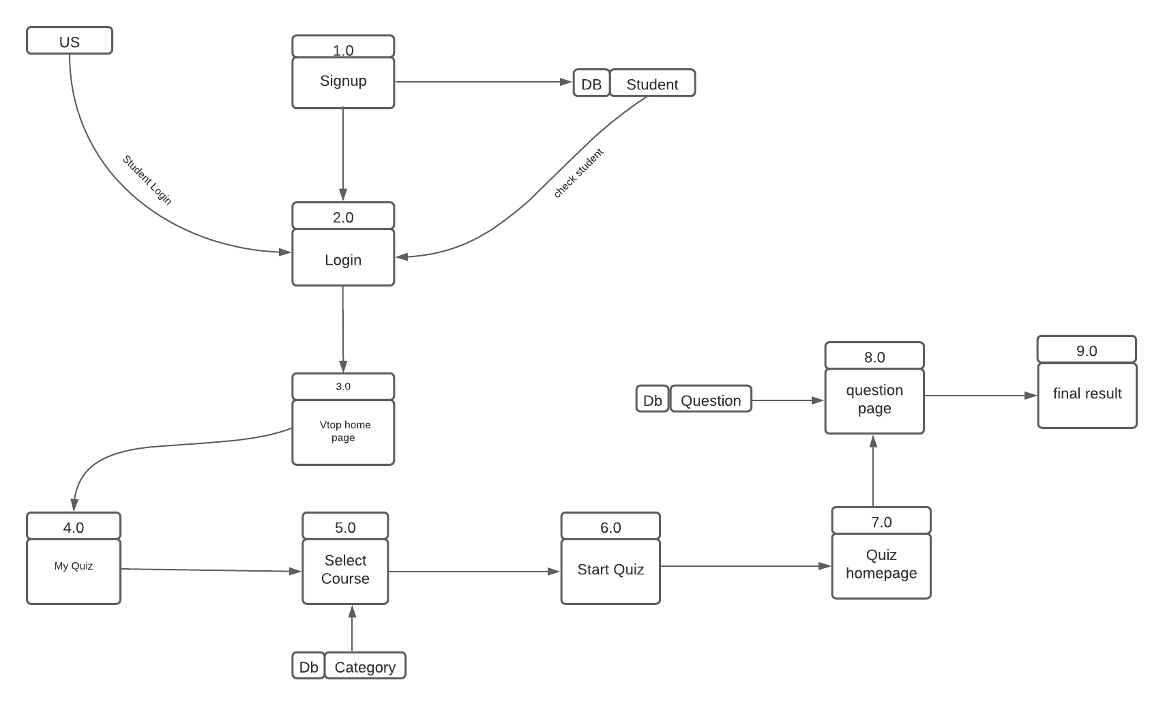
Quiz Portal flow chart

Slide 5
Module:
Using Notepad++ editor and Xampp for Database.
Backend Side: -
1.PHP (Managing Backend Process).
2.Used Xampp server (For database management)
3.Apache Webserver(Establishing Connection Between Web (Localhost) and Server)
4.MySql Database.
4.PHP OOP Classes and Objects (For Functional Purpose).
Frontend: -
1.PHP (fetching data from database and reflect it on frontend like login details and Quiz Questions)
2.HTML (Design of Webpage)
3.Used Vtop Source Code for reference (Frontend design).

Slide 6
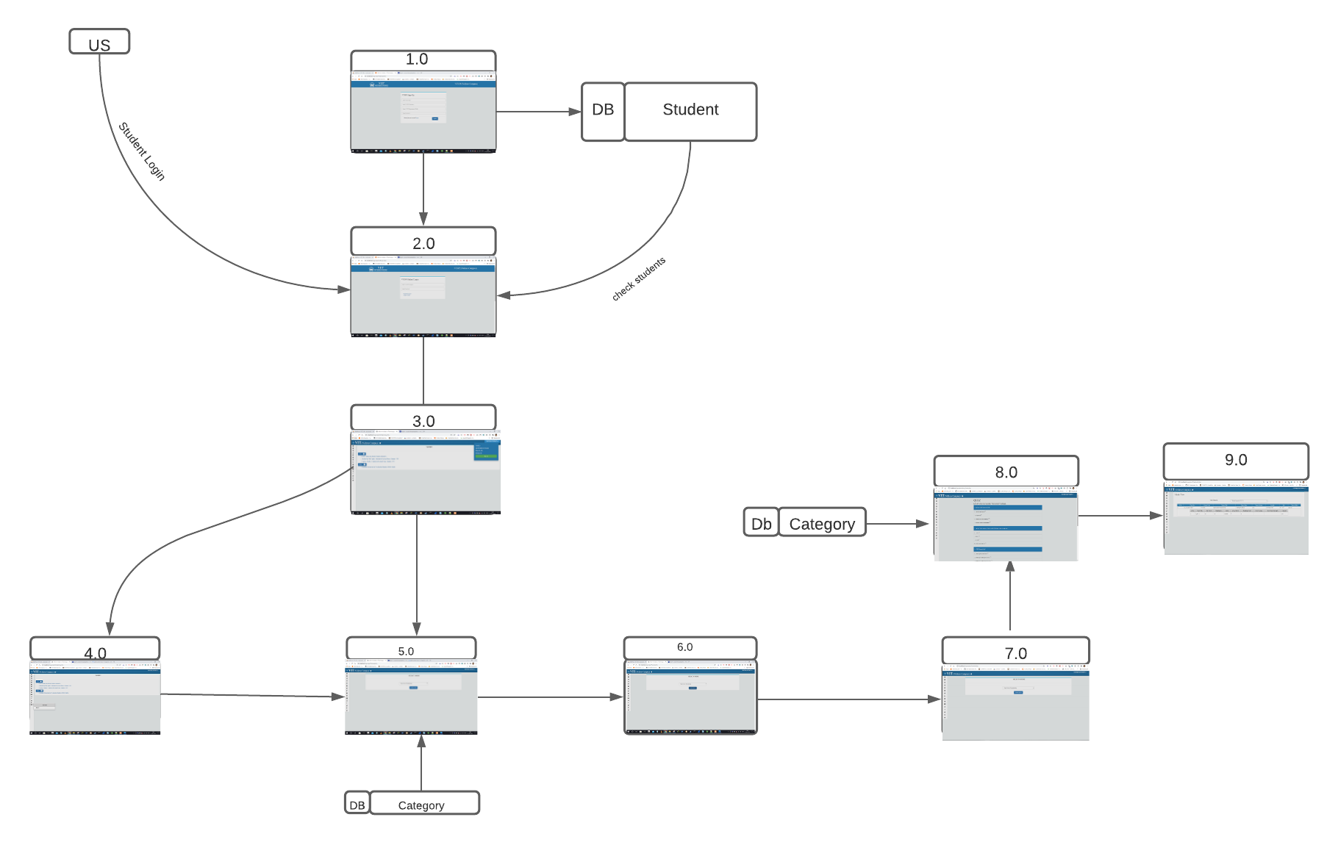
Prototype

Slide 7
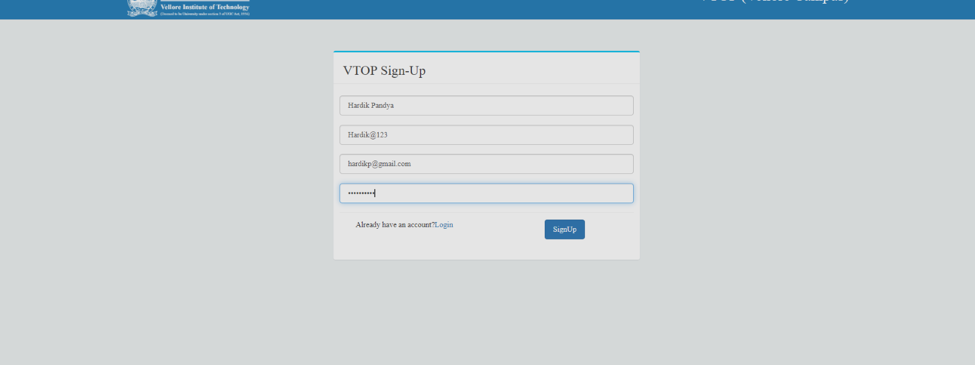
Complete Front-End Design:
Signup.php
name=Hardik@123.
email=hardikp@gmail.com.
pass=Hardik@123.
user=Hardik Pandya.

Slide 8
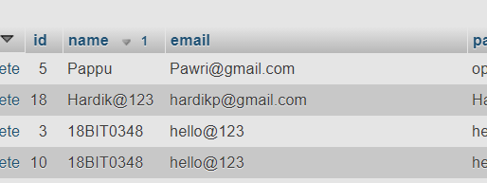
Signup Database:-
id=18 Hardik@123

Slide 9
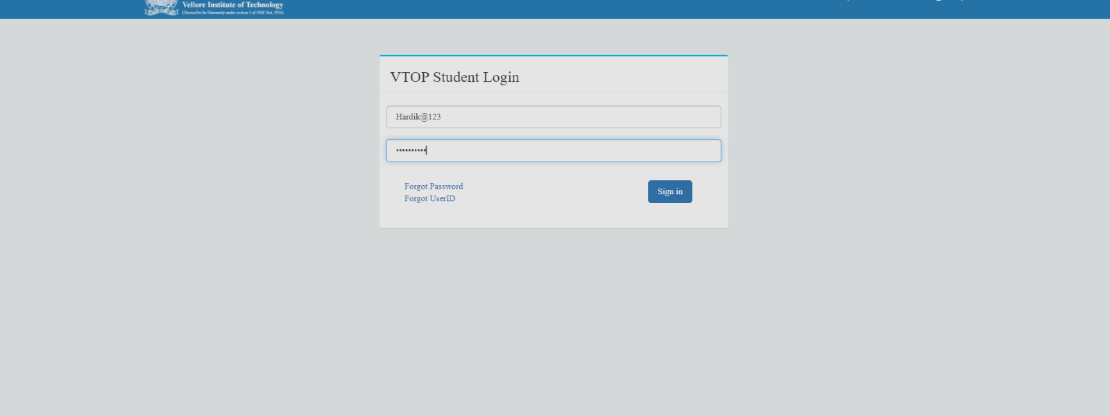
Vitlogin.php
user=Hardik@123.
pass=Hardik@123.

Slide 10
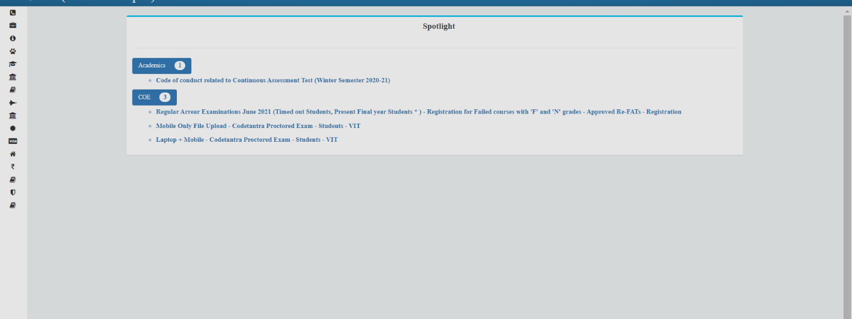
Vtophome.php

Slide 11
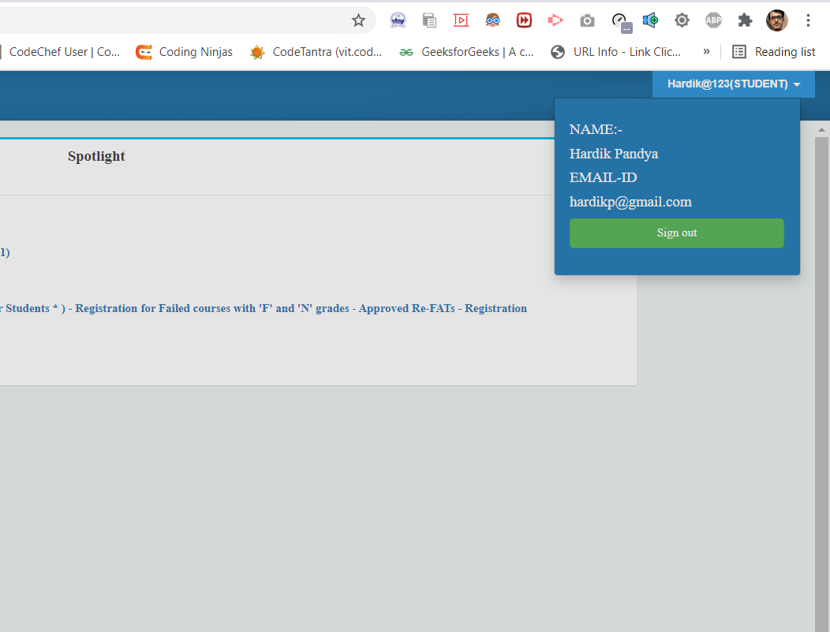
User Profile
Shows user profile

Slide 12
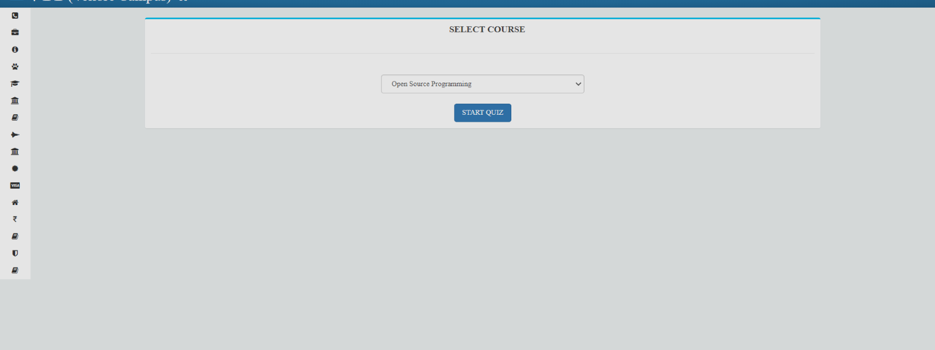
home4.php
Shows quiz home page. Here we need to select the course to give quiz

Slide 13
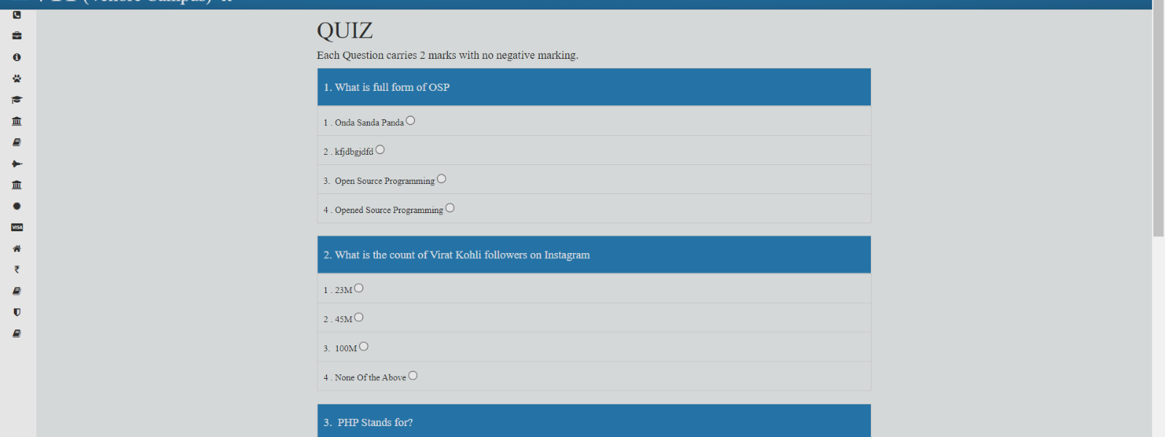
Question
After selecting the course question for that quiz are displayed

Slide 14
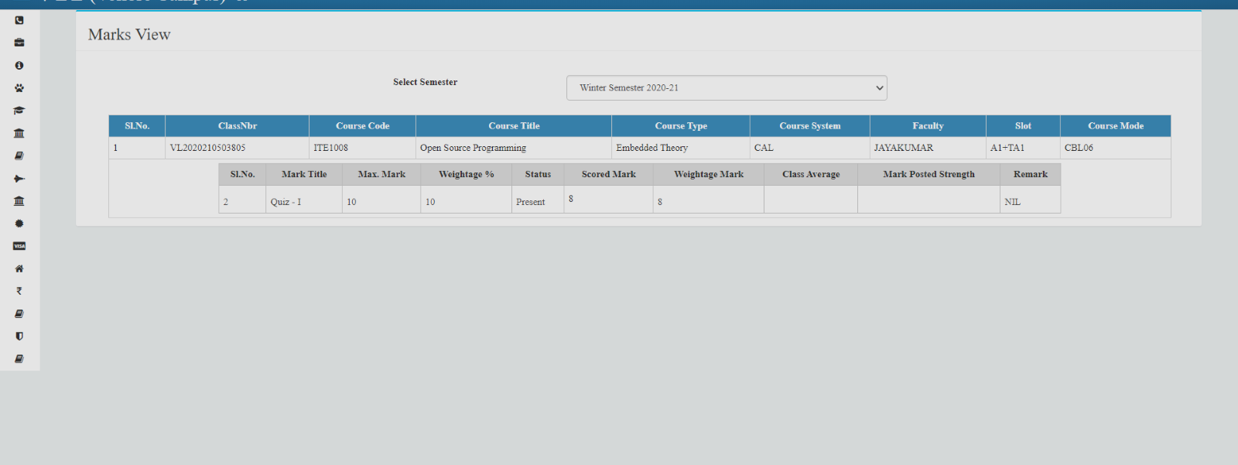
finalresult.php
Shows result

Slide 15
Database Details
Signup:-This is for storing signup details of the user. In this database table there are 5 columns id, name, email-id, pass and user. With the help of name and pass students will login into the portal. So here id is the primary key.
Categories:- This is for storing subject's category. Of which category(subject) student have to give quiz. In this Database table we have total 2 columns id and cat_name. This cat_name will be used in showing the question of that respective category. Here id is primary key.
Questions:-This is for storing all the questions and the solutions of that respective questions with their id in category database. This database have total 8 columns id,question,ans1,ans2,ans3,ans4,ans_cat_id. Here cat_id is foreign key and id is Primary Key.

Slide 16
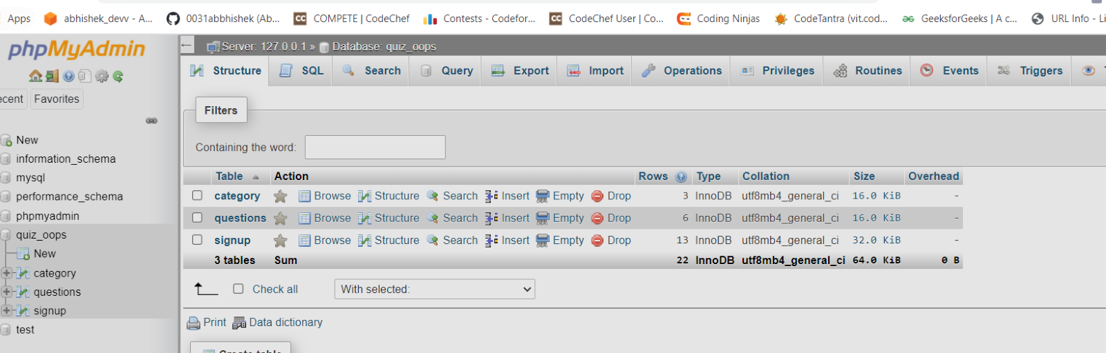
Database Details
1) Signup
2)Category
3)Questions

Slide 17
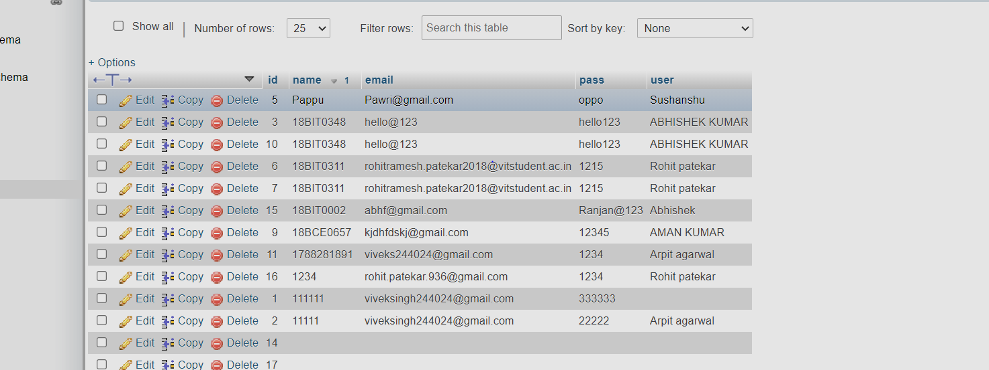
Signup Database
id→Primary Key

Slide 18
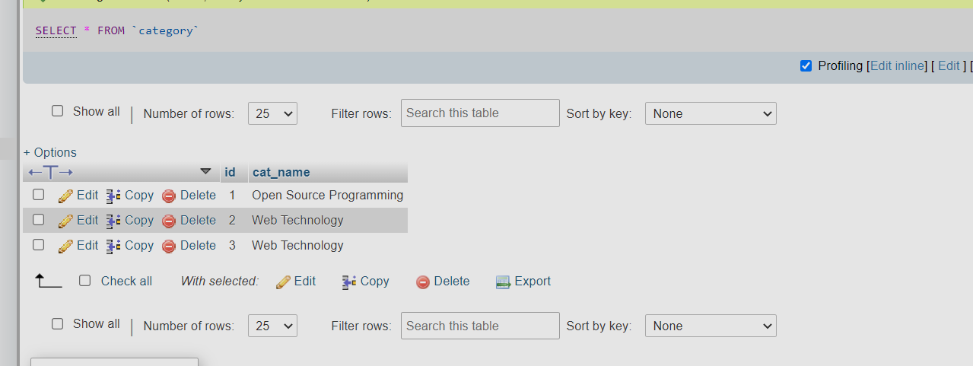
Category Database
id→Primary Key

Slide 19
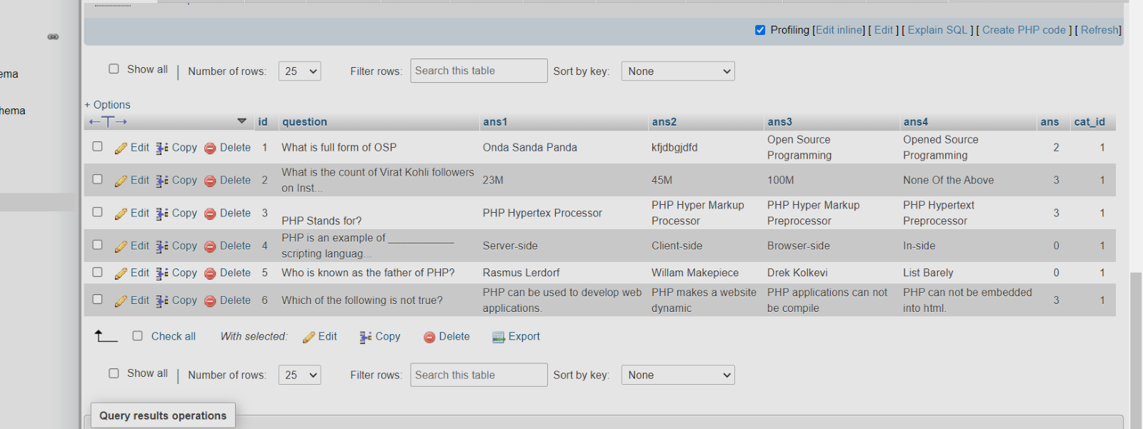
Questions Database:-
id→Primary Key
cat_id_→ Foreign Key

